Slide 1
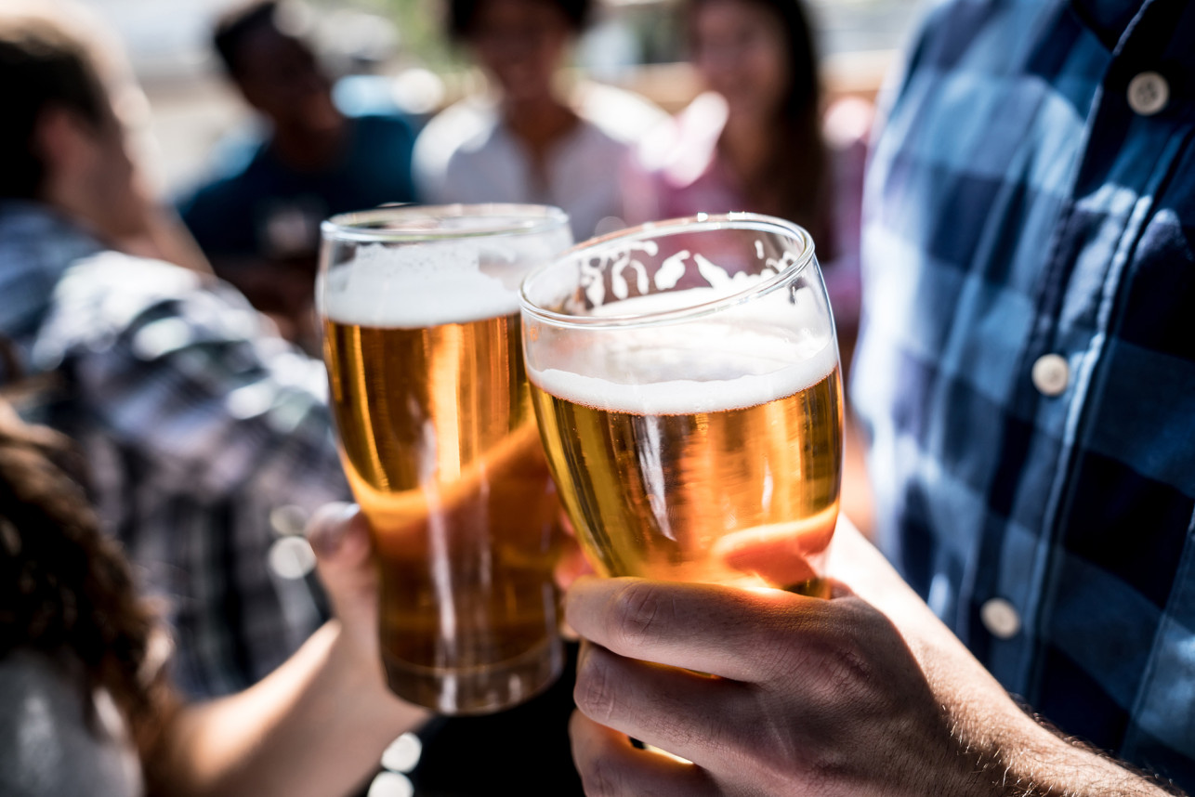
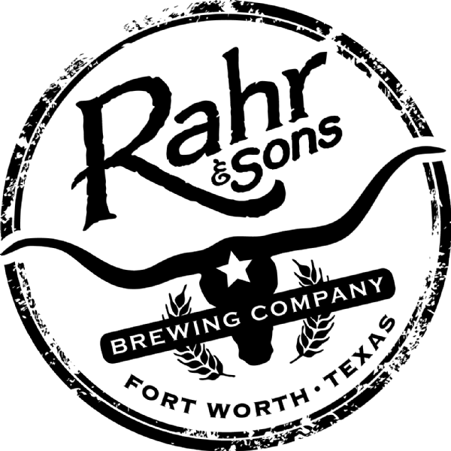
Brew-Forward 2019
Brewpub placement in the Dallas area
We see Rahr & Sons missing out on market share as a brewery due to its’ large-scale operation and adapting to customer demand.
Notes:
Hello, we recently had the opportunity to show potential property for a new BrewPub to your Brew Master Fritz. He loved the idea of expanding Rahr in to the brew pub market and asked that I review the marketing data with you.

Slide 2
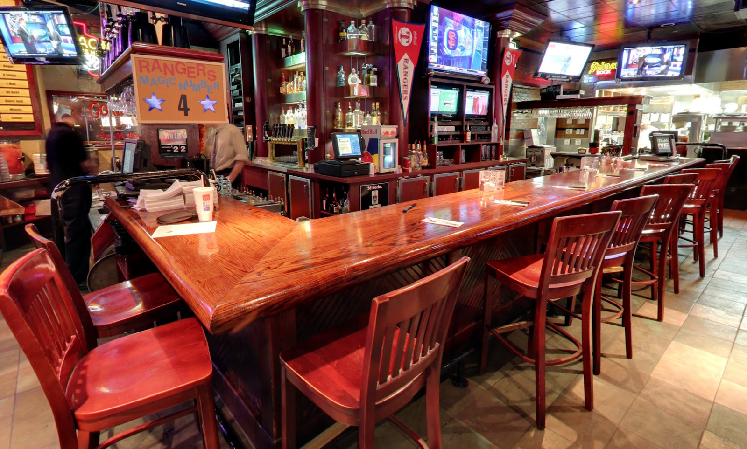
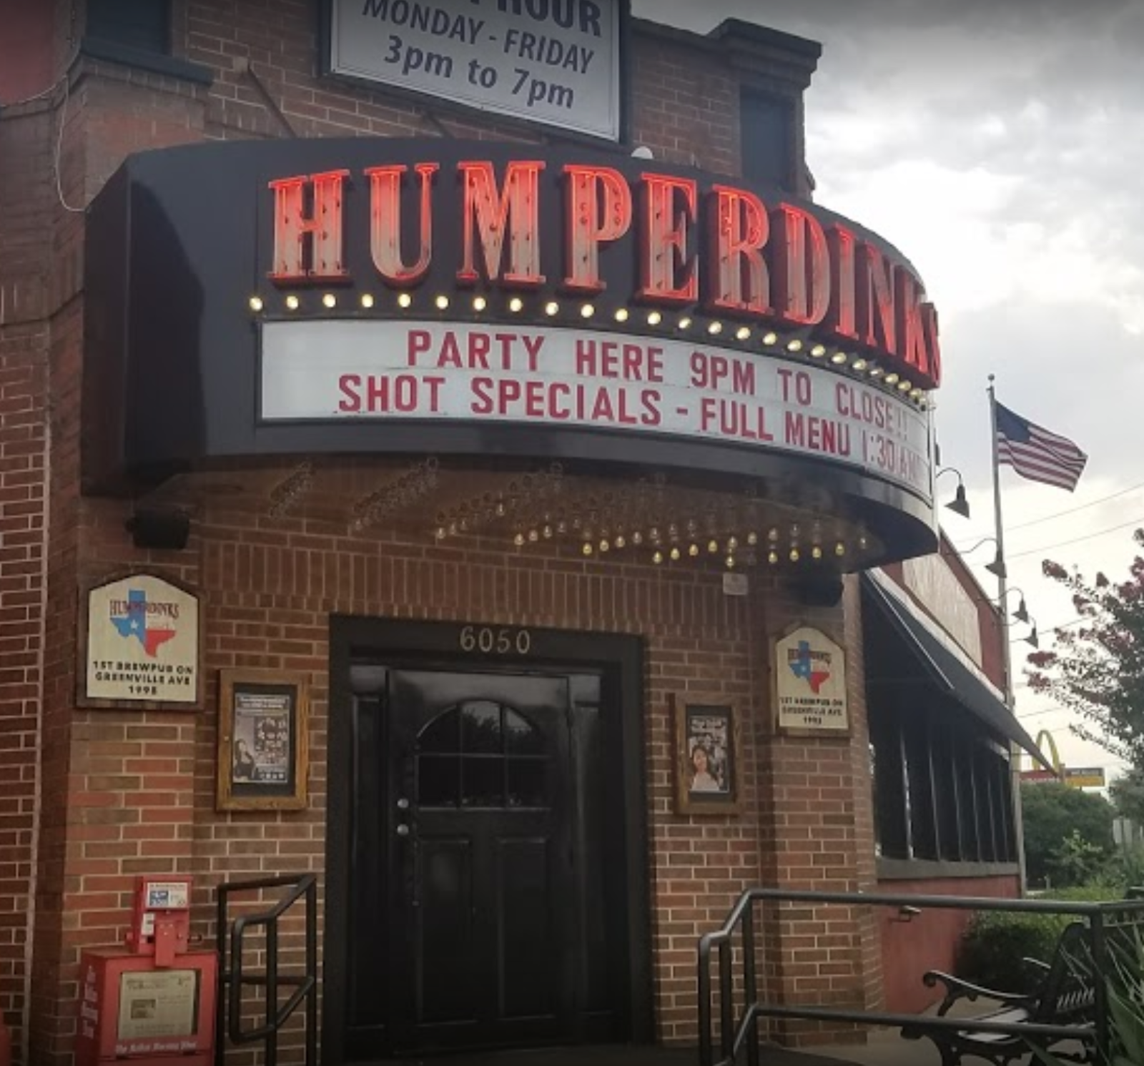
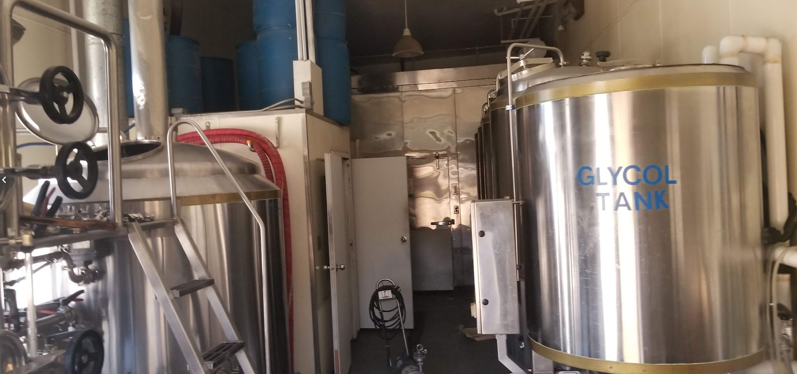
Why Now
There is a perfect opportunity at an existing brewpub location in the Dallas area.
Notes:
To recap, the goal of our presentation to Fritz was to recognize a missing market share from patrons who are always looking for the latest beer trends. We believe we found you opportunity enter into the brewpub space quickly at a reduce cost. The former Humperdinks Brewpub in the Lower Greenville neighborhood of Dallas offers a 15-barrel brewhouse allowing you to brew up 5 distinct beers a week.

Slide 3
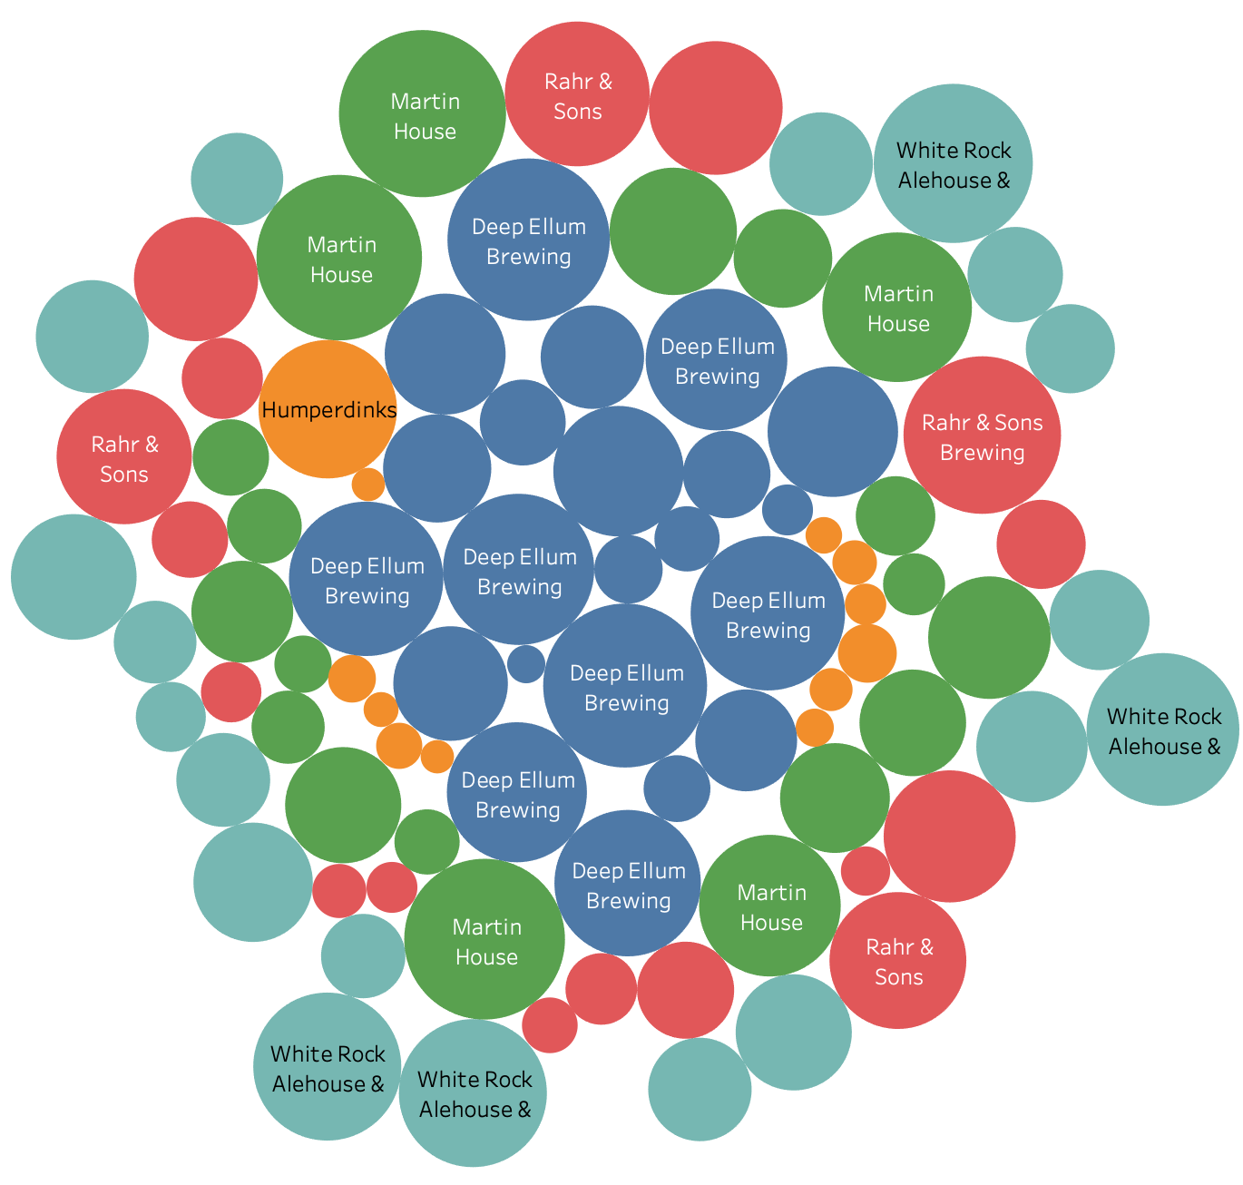
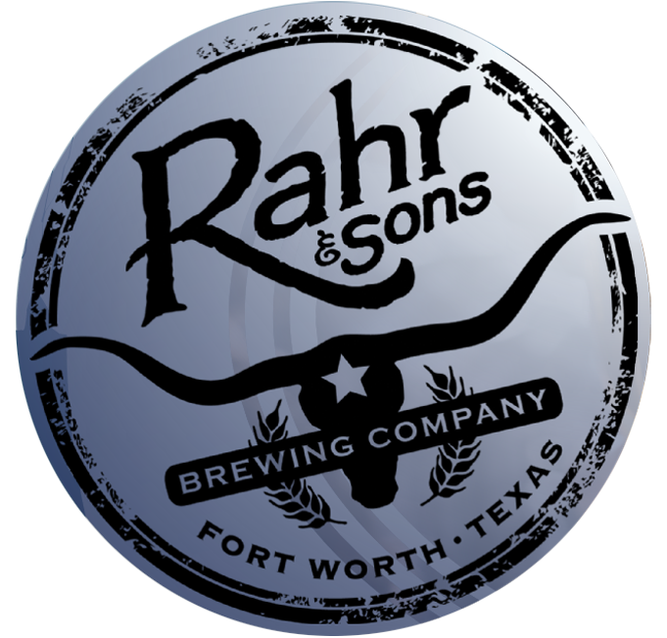
Untappd Beer Ratings
Humperdink‘s, on average, has the worst ratings compared to its competitors
Humperdinks has 1 high rated beer style, the stout
Deep Ellum Brewing Co. recently opened a brewpub in Fort Worth, Deep Ellum Funkytown Fermentorium
Notes:
In order to understand why Humperdinks failed, we wanted to see how consumers perceived their beers. Using data provided by Untappd we compared the top 25 beers from White Rock Ale Works, Rahr and Suns, Deep Ellum, Humperdinks, and Martin House. From our graph you can see Humperdinks has the lower rating out of these breweries. We have included Deep Ellum, since they recently opened a new brewpub in Fort Worth allowing them to create new beer styles, not once available to them at their brewery.

Slide 4
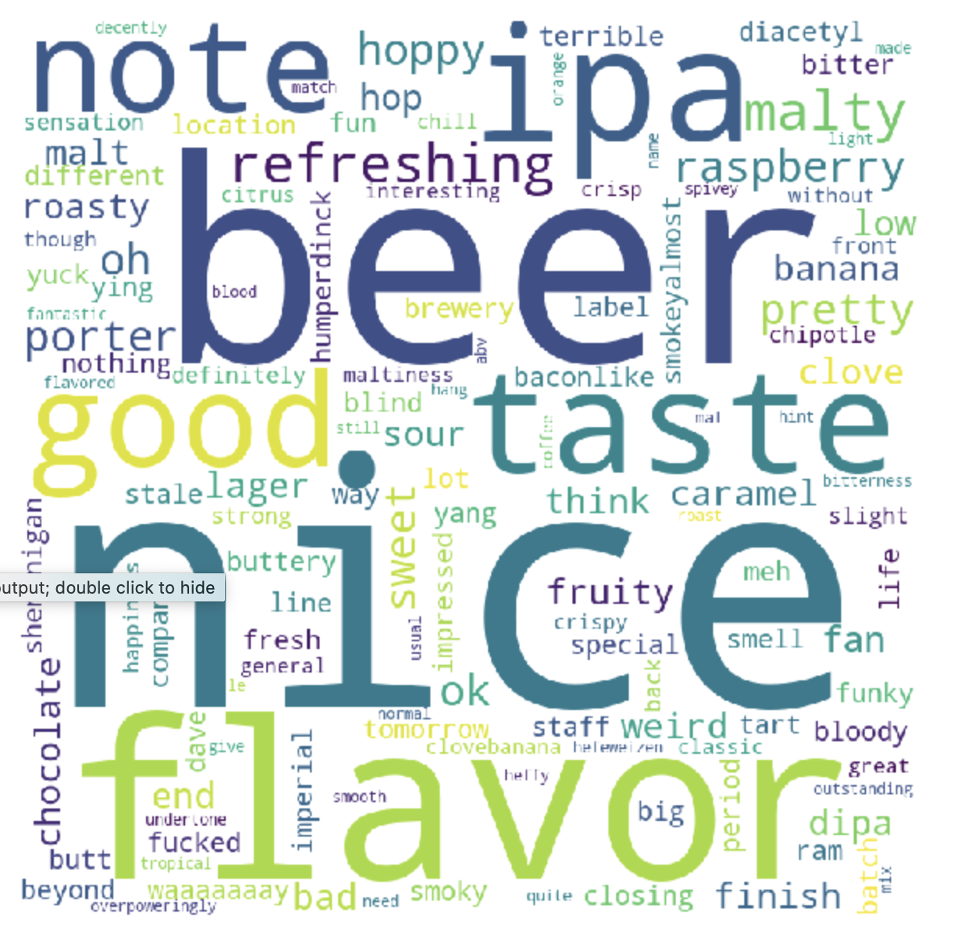
Untappd Customer Response
The most common word was Nice
You won’t want to see words like diacetyl or applies.
Notes:
Even though, the ratings were poor, customers who used Untappd is comment positively about the beers they drink. Review the comments, it is noticeable that quality is dropping due to words like apples and diacetyl.

Slide 5
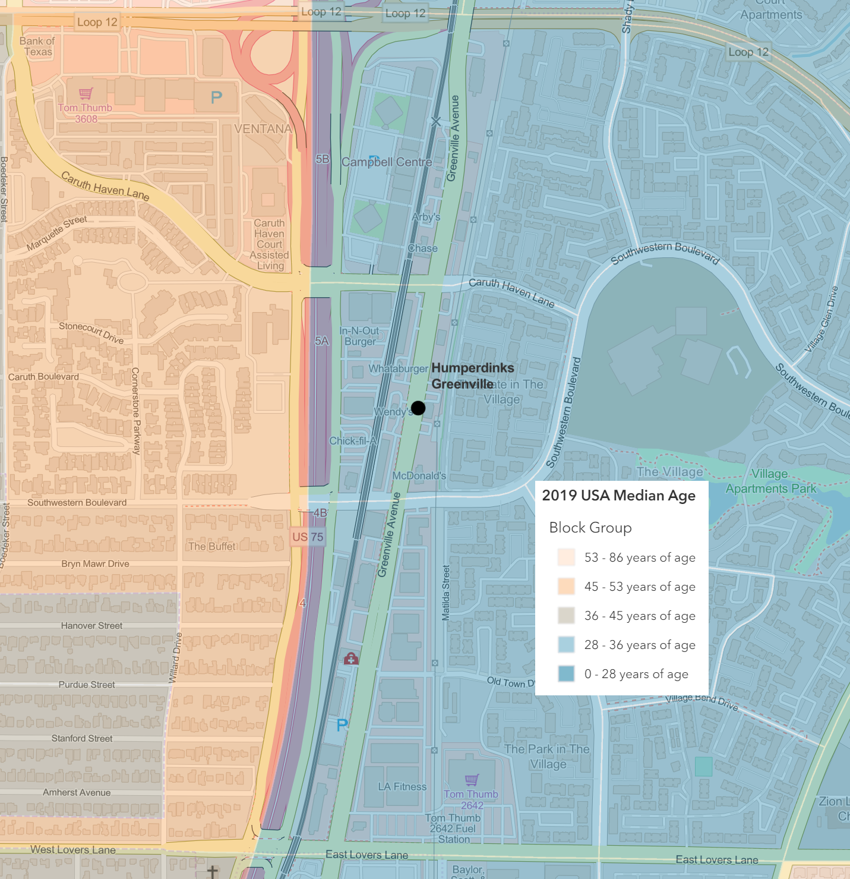
The Area
2019 Data
Median Age: 28 to 36
Disposable income: $39,000 to $188,000
Traffic Counts: Greenville Avenue are - 24,008 North Central Expressway - 322,801
The area shows to able to handle a newly reopened brewpub.
Notes:
The area shows to be able to handle a newly reopened brewpub,
with the 2019 median age being 28 to 36 and one censes track away being 45 to 53.
The disposable income, alone, in the area ranges from $39,000 to $188,000 per household.
Traffic counts on Greenville Avenue are 24,008 and on North Central Expressway, just, a 10th of a mile away going up to 322,801 per day.

Slide 6
The right neighborhood
Using Principal Component Analysis (PCA) and K-Means Clustering, we identified 6 unique clusters of zip codes in Texas
Data used is demographic details on income, age, and housing for each zip code in Texas
We found that most of the breweries are in Cluster Label 1, which is predominantly industrial areas.

Slide 7
The Greenville Neighborhood
Humperdinks location is found in Cluster Label 5
This cluster has, on average, the most mature breweries and brewpubs in Texas
We also know they have the highest monthly Untappd check-ins
On average, the beer rating is 3.7 compared to Humperdinks 3.3 average rating

Slide 8
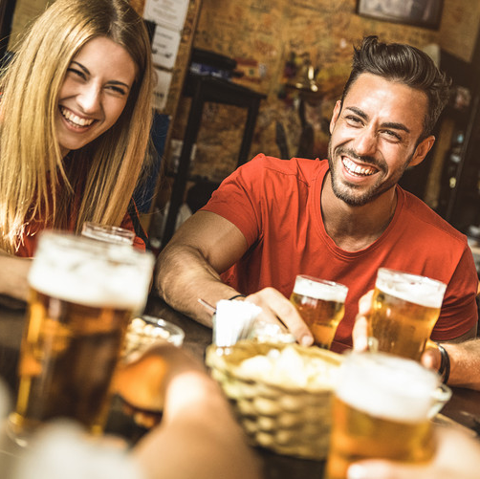
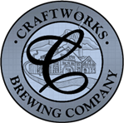
Business Model
Lease and retrofit Humperdink’s Resturant with existing brewhosue
Establish membership program, offering mugs, food discounts, rewards for unique beers
High rotation of beers, instead of 30 standard offerings we offer 100 unique beers year around
Investment
Space
Profit
Long term lease:
$3.70 - SF
6,785 bring the monthly total to $25,104.50
Full-size bar
Large areas for eating a gaming
15-barrel brewing area
Money will be generated by offering craft food & in house and carry away beer sales.
Loyalty membership program
Notes:
The building is for long term lease at $3.70 a square foot.
The space contains a full-size bar, large areas for eating a gaming section and a 10-barrel brewing system.
In this setting smaller means faster.
A 15 barrel brewhouse at 50 brew weeks per year is able to produce 15 different brews per week.
In new operations 2-3 brews per week is common.
The total square footage is 6,785 bring the monthly rent to a little over 25 thousand.
Money will be generated by food and in house and carry away beer sales.
There will be a membership program to encourage customer loyalty and return.
Several beers will be on tap including Rahr & Sons’ staples as well as rotating inhouse beers.

Slide 9




Thank You
Chris Ballenger & Chad Madding
+1 555-0100
chris@rahrbrewing.com
rahrbrewing.com
Notes:
Thank you for allowing us to share this exciting opportunity with you today. If you have any questions, please do not hesitate to contact us.

